Slide 2
Table of contents
Introduction
Data processing
Models
Possible improvements

Slide 3
Introduction
Goal of the project and Data available

Slide 4
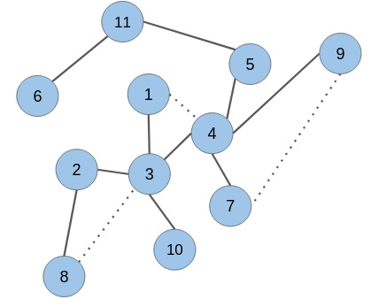
Goal of the project
?
?
?
The nodes represent scientific papers and the edges in the graph represent links between them, indicating if one paper cites another.
Given a papers citation graph along with the authors and abstract of each paper, we need to predict if there is a link between a new pair of nodes (papers).

Slide 5
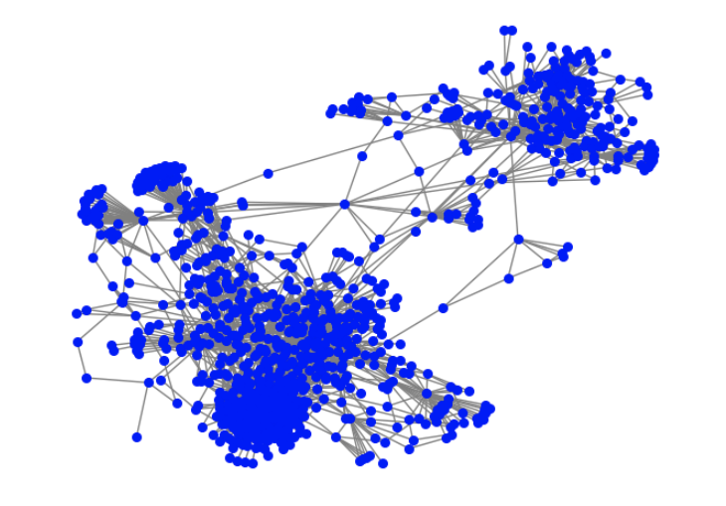
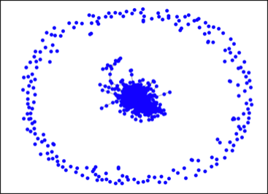
Data understanding
Graph
Number of nodes = 138,499
Number of the edges = 1,091,955
1000 first nodes of the graph
1000 second nodes of the graph
Abstracts
 | Before normalization | After normalization
Number of abstracts | 138,499 | 138,499
Empty abstracts | 7,249 | 7,249
Long abstracts (> 128 words) | 82,394 | 11,217
Very long abstracts (> 256 words) | 4,171 | 95
Huge abstracts (> 512 words) | 65 | 12
Longest sentence | 1,462 | 915
Number of words of vocabulary | 345,570 | 188,891

Slide 6
Data processing
Feature engineering: extracting features from the data

Slide 7
Data processing overview
Models
Validation
Val_indices
Edge_list.txt
Walks
Training
Adj
Indices
Authors.txt
BART embedding
Word2vec mean
Abstracts.txt
Tf_idf
List of wordfs embeddings

Slide 8
Random walks
Random walks parameters to generate node features from the graph:
Num walks | 10
Walk length | 15

Slide 9
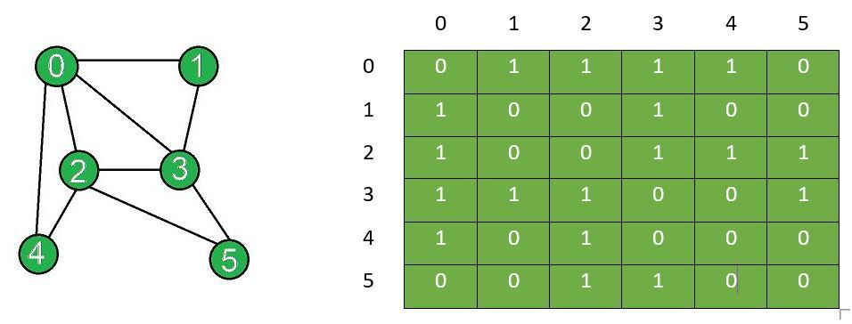
Adjacency matrix
Then Adjacency matrix normalization to ensure:
scaling values to a similar range
Symmetry
Information propagation
Notes:
This function performs symmetric normalization of the adjacency matrix of a graph. It first adds the identity matrix to the adjacency matrix to ensure that every node is connected to itself. Then it computes the degree of each node by summing over its adjacent edges. The inverse of the degree is then taken and diagonalized to obtain the diagonal matrix D_inv. Finally, the adjacency matrix is multiplied by D_inv to get the normalized adjacency matrix A_hat. This normalization ensures that the sum of the rows of A_hat is equal to one, which is desirable for many applications in GNNs.
-
- Information propagation: Normalization can also help to ensure that information propagates effectively through the graph. In some cases, without normalization, information may get trapped in certain parts of the graph and fail to propagate to other parts.

Slide 10
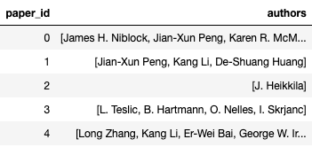
Authors data
Enriched pairs
authors
paper_1 | paper_2 | same author | common authors
0 | 1 | 0 | 0
2 | 3 | 1 | 1
4 | 7 | 1 | 3
5 | 7 | 0 | 0
Papers
Pairs
Adding same authors flag to pairs
One hot sparse representation

Slide 11
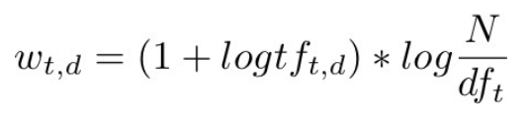
Tf_idf matrix
Weights of tf_idf:
Terms of the vocabulary
Increases with the number of occurrences within adocument. (tf)
Increases with the rarity of the term in the collection. (idf)
Documents
Notes:
- increases with the number of occurrences within a
document. (tf)
- increases with the rarity of the term in the collection. (idf)

Slide 12
BART-1024 abstract embedding
BART (Bidirectional and Auto-Regressive Transformer) uses the Transformer architecture which includes self-attention layers to encode the input sentence.
The sentence embedding is a weighted sum of the word embeddings, where the weights are learned during training based on the task at hand.
This model has been used as a function without finetuning to the task of our project.
Abstract:
“word1 word2 word3
word4 word5 word6”
BART
Abstract embedding:
Shape = (1024,)
Notes:
The BART model in Hugging Face returns a dictionary of different outputs, but the main one is usually called "last_hidden_state". This output has a shape of (batch_size, sequence_length, hidden_size), which means that for each input sequence in the batch, you get a matrix of shape (sequence_length, hidden_size) that contains the encoded representation of each token in the sequence. In the case of BART, the hidden_size is 1024, so this is why you see the output described as "1024".
In addition to "last_hidden_state", the BART model also returns other outputs such as "encoder_last_hidden_state", "decoder_last_hidden_state", "encoder_hidden_states", and "decoder_hidden_states". These outputs contain the hidden states of the encoder and decoder layers of the model, which can be useful for various downstream tasks such as sequence generation or text classification. BART (Bidirectional and Auto-Regressive Transformer) uses the Transformer architecture which includes self-attention layers to encode the input sentence.
During the encoding stage, each word in the input sentence is first converted into a word embedding. Then, the self-attention mechanism is used to compute the attention weights for each word in the sentence. These attention weights are used to compute a weighted sum of the word embeddings to obtain the sentence embedding. The attention weights indicate the relative importance of each word in the sentence to the task at hand, and this information is used to compute the sentence embedding.

Slide 13
Pretrained Goog-300 word2vec
Pretrained word2vec model on Google news data set that returns words embeddings of shape (300,)
Abstract:
“word1 word2 word3
word4 word5 word6”
Goog300 w2v
Words embeddings:
[emb1, emb2, emb3,
Emb4, emb5, emb6]
Mean
Abstract embedding:
Shape = (300,)
Notes:
This function performs symmetric normalization of the adjacency matrix of a graph. It first adds the identity matrix to the adjacency matrix to ensure that every node is connected to itself. Then it computes the degree of each node by summing over its adjacent edges. The inverse of the degree is then taken and diagonalized to obtain the diagonal matrix D_inv. Finally, the adjacency matrix is multiplied by D_inv to get the normalized adjacency matrix A_hat. This normalization ensures that the sum of the rows of A_hat is equal to one, which is desirable for many applications in GNNs.
-
- Information propagation: Normalization can also help to ensure that information propagates effectively through the graph. In some cases, without normalization, information may get trapped in certain parts of the graph and fail to propagate to other parts.

Slide 14
Word2vec on vocabulary abstracts
Pretrained word2vec model on Google news data set that returns words embeddings of shape (300,)
Word2vec model
Trained word2vec
Abstracts
Vocabulary
Training the model on the vocabulary
Abstract:
“word1 word2 word3
word4 word5 word6”
Trained word2vec
Words embeddings:
[emb1, emb2, emb3,
Emb4, emb5, emb6]
Mean
Abstract embedding:
Shape = (300,) or (192,)
We kept the words embeddings after truncating and padding to a fixed length of 128 words try to create better nodes features of shape (128, 192)

Slide 15
Models
GNN model finetuned and enriched with features

Slide 16
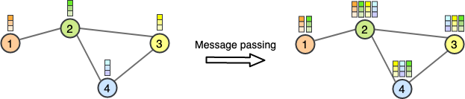
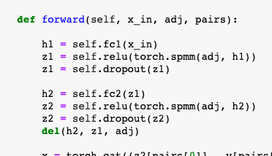
GNN model
The node features are updated by aggregating and passing messages from neighboring nodes in the graph.
The message passing step involves multiplying the adjacency matrix by the transformed node features, resulting in a new node feature matrix
Notes:
The forward pass of the model first applies a linear transformation to the node features, followed by message passing using the adjacency matrix. The message passing step involves multiplying the adjacency matrix by the transformed node features, resulting in a new node feature matrix of shape (N, out_features)
The message passing process typically involves three steps: message computation, aggregation, and update.

Slide 17
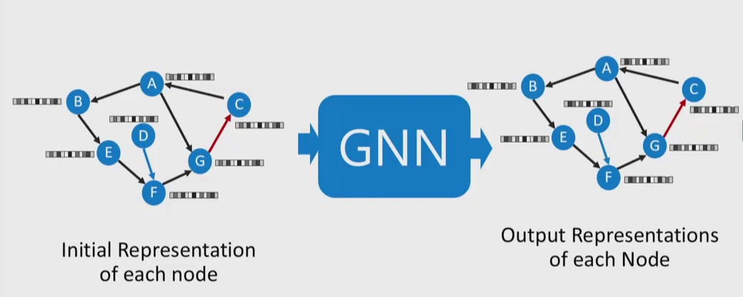
GNN model with node features
Node features :
Random vector
Random walks
Abstract embedding
node features | log loss val
walks_wv | 0,2464
local_wv_300 | 0,2942
goog300 | 0,2979
bart1024 | 0,3208
tf-idf | 0,3310
random | 0,4358

Slide 18
Basic architecture
Message passing
Walks node features
fc
mm
mm
Pairs embedding
fc
fc
Output
Conca-tenate
Adjacency
matrix
Adjacency
matrix
Pairs
Common authors

Slide 19
Adding authors features
Pairs features: author flag or count
One hot sparse representation
authors
Enriched pairs
paper_1 | paper_2 | same author | common authors
0 | 1 | 0 | 0
2 | 3 | 1 | 1
4 | 7 | 1 | 3
5 | 7 | 0 | 0
Papers
Multiplying pairs features by the authors flag
Best val log loss score: 0,2442
Apply a Dense layer to densify authors representation
Best val log loss score: 0,2442

Slide 20
Architecture with authors
Walks node features
fc
mm
mm
Pairs embedding
fc
fc
Output
Same authors flag
Adjacency
matrix
Adjacency
matrix
Pairs with authors
Sparse authors
fc
Pairs embedding
fc
fc
Conca-tenate
Output
Sparse authors
Walks node features
fc
mm
mm
Pairs embedding
Adjacency
matrix
Adjacency
matrix
Pairs

Slide 21
Adding abstracts features
Adjacency
matrix
Adjacency
matrix
Pairs with authors
Walks node features
fc
mm
mm
Pairs embedding
Conca-tenate
fc
fc
Output
Abstract embedding
fc
Pairs embedding
Text features | Log loss score
Mean local w2v 300 | 0,2027
Max local w2v 192 | 0,2119
Mean Goog300 | 0,2542
Bart 1024 | 0,4981
Tf_idf | (out of memory)
Pairs

Slide 22
Possible improvements
Detected during the project and tested

Slide 23
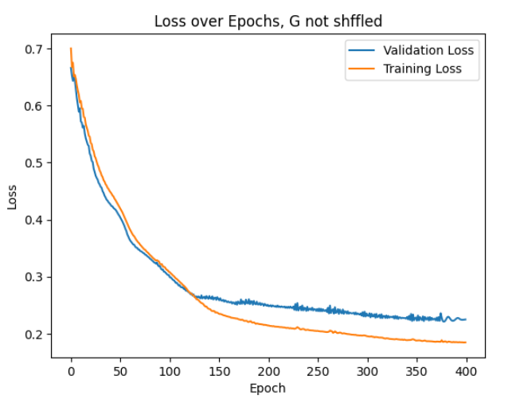
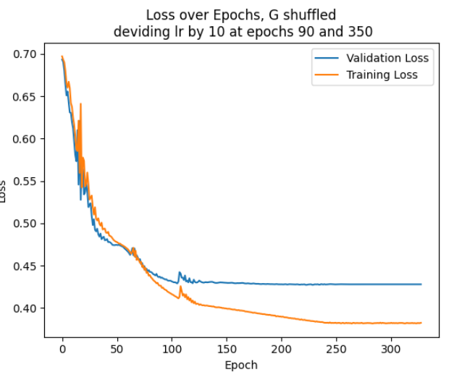
Shuffling graph nodes

Slide 24
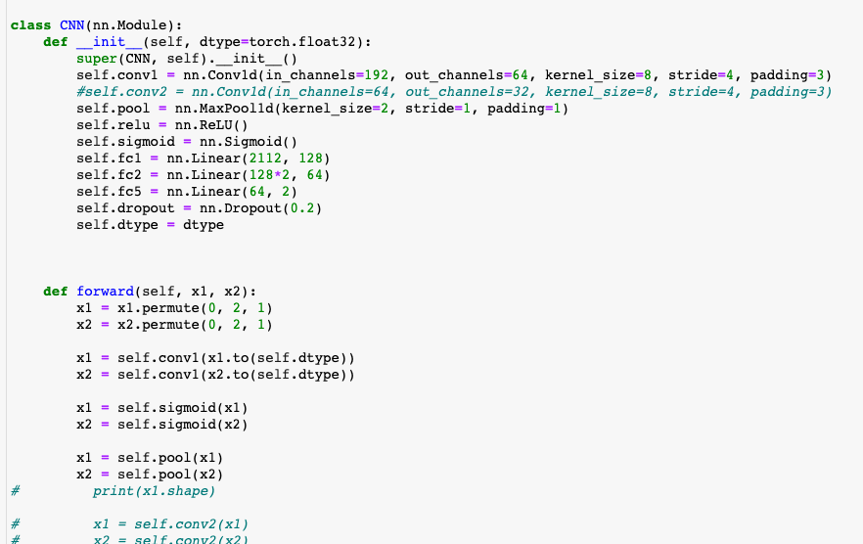
CNN to extract abstract embedding
Still in progress...
Challenges with the data volumetry:
Shuffling abstracts
Taking a sample of abstracts and keeping correspondent pairs of nodes
Applying batch size

Slide 25
Message passing
abstract1
conv1d
mm
mm
Pairs embedding
fc
fc
Output
abstract2
Pairs

Slide 26
Conclusion

Slide 27
GNN + walks provided very interesting results.
Authors flag is as relevant than sparse one hot respresentation, and is more interesting for performance purposes.
Text with words embedding mean (or max) did not bring interesting improvement, we need to study the words in their context.

Slide 28
Thank you

Slide 29
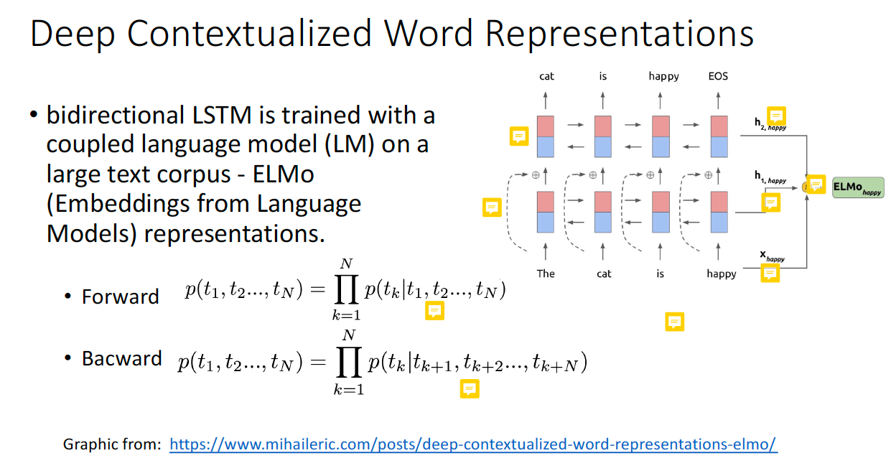

Slide 30
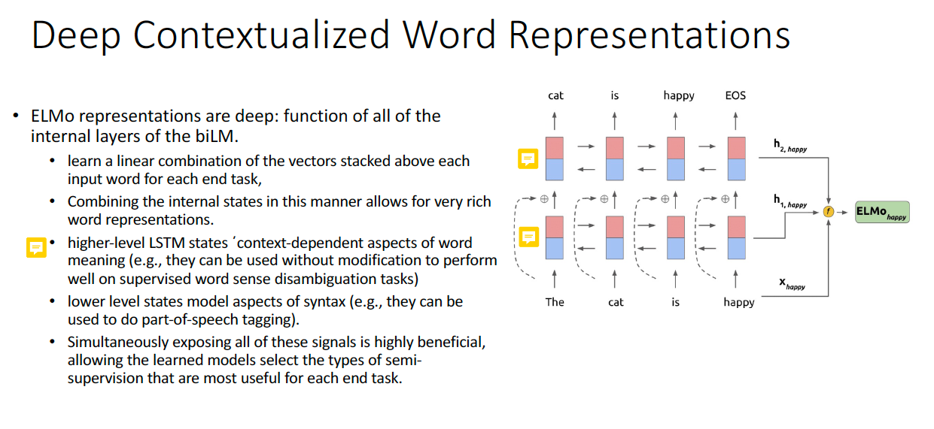

Slide 31
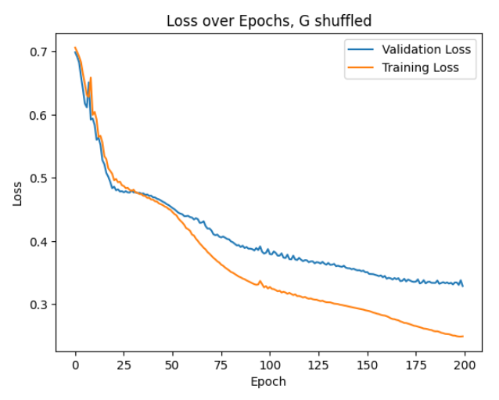
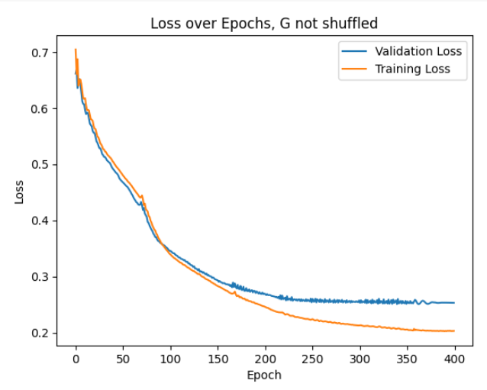
Sparse authors

